Slide 1
HEALTH CARE INSTITUTION "3rd CITY DENTAL POLYCLINIC"

Slide 2
Health care institution "3rd City Dental Polyclinic"
Opened its doors in 1958. It was located along Zakharova Street, 16 until 1983, after which it was renamed into Kiseleva Street, 5.
Since January 2008, the polyclinic has been providing emergency medical care in dentistry on request, without restrictions, within the limits of treatment and diagnostic capabilities at night, Sundays and holidays.
Currently, the following dental departments function and provide services in the clinic:
Dental department №1:
- provides planned assistance to the territorially attached population in therapeutic and surgical dentistry.
Paid dental department:
- provides services in therapeutic and surgical dentistry;-professional oral hygiene;
- fissure sealing;
- office whitening and splinting of teeth;
- treatment of caries and non-carious lesions using modern composite materials;
- root canal treatment (including the use of rotary instruments and filling by injection of thermoplasticized gutta-percha);
- removal of teeth of any complexity;
- dental implantation;- operation "sinus-lifting";
operation of cystectomy with resection of the root apex;
- tooth-preserving operations;
- removal of neoplasms;
- removal of exostoses;
- extraction of teeth using the VarioSurg ultrasonic device.
Dental department №2:
provides emergency medical care in dentistry on request, without restrictions, within the limits of treatment and diagnostic capabilities at night, Sundays and holidays in therapeutic and surgical dentistry.
Orthopedic department:
- provides prosthetics services;
- non-removable prosthetics (solid, metal-acrylic, metal-ceramic, metal-free crowns);
- prosthetics on implants (various manufacturers);
- removable prosthetics (partial removable lamellar dentures, complete removable lamellar dentures, clasp dentures, acetal dentures, nylon dentures).

Slide 3
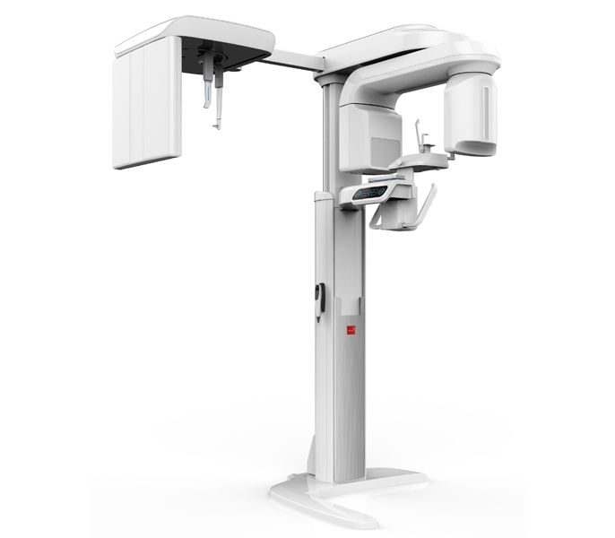
HEALTH CARE INSTITUTION "3rd CITY DENTAL POLYCLINIC« Represents a project: "CBCT - modern diagnostic technology"

Slide 4
Relevance: necessity of highly effective diagnosis of diseases of the dentoalveolar system for the treatment of diseases of the maxillofacial area, prosthetics, restoration of lost chewing and aesthetic functions; ensuring a high level of dental care, the exclusion of complications during treatment. Cone beam computed tomography is a mandatory diagnostic measure, included in the treatment protocols for patients with diseases of the maxillofacial area and is used in surgical dentistry, prosthetics and implantation, diagnostics at the stages of endodontic treatment, diagnostics during orthodontic treatment. Social significance: the project is aimed at the modernization and development of the health care institution "3rd City Dental Clinic". Target group: patients of the health care institution "3rd city dental clinic", including disabled people and pensioners who need to be provided with technical means of social rehabilitation. Total funding: 70 000 US dollars Donor funds: 60 000 US dollars, co-funding: 10 000 US dollars Contact person: Muzykantova Victoria Olegovna, chief physician of the 3rd city dental clinic, 8 (017) 350 14 13, 8 (044) 738 36 96, e-mail: info@3gsp.by; Tselishcheva Elena Yuryevna, legal adviser of the 3rd city dental clinic, 8 (017) 353 67 56, 8 (029) 373 80 48, e-mail: kadr@3gsp.by

